Slide 1

Save a Quarter (Bring Your Own Coffee Cup)
Team 2
Billy Choy
Ashley Keung
Jonathan Chu
Karishma Karna
Surabhi Nagi

Slide 2

Some statistics
Material decomposition of cups – paper + polyethylene
As per a study by UBC, about 20 million trees cut annually to meet the demand for paper cups.
9000-12000 kg of steam 960- 1000 kWh electrical power and 50m3 cooling water required to process these raw materials into the finished products.
Notes:
Material decomposition of coffee cups
Difficult to separate the polyethylene layer hence making them difficult to dispose
Manufacturing them not environmental friendly – resulting in deforestation and enormous use of energy

Slide 3

Our Objective
Aim to reduce the use of disposable coffee cups to reduce the use of plastic
Raise awareness of bringing your own cup culture
Make everyday coffee sustainable and pocket friendly
Notes:
Problem: We observed that many students were carrying paper cups for their drinks around the college and we are trying to promote the idea of using less non-reusable material to bring out the sense of sustainability. With the support of the data provided by LSU cafe, only 18% of the customers are using their own cups with 27 days of data. We are hoping to promote the benefit of using our own cups and the newly imposed law on reusable cups.
Solution: We are going to build a campaign to promote Bring Your Own Cup (BYOC). Promotions will include posters, videos, social media posts (LSU Instagram post/ IE Instagram post etc).

Slide 4
Milestones
The consent of the coffee shops
Gather current data(before event) of people who bring own cups
Obtain permission to post the posters
Promote on MMC & LSC social media channels
Event day preparations – Souveniers
Creating an online survey form
Post event data collection and analysis
Notes:
Asked the consent of LSU, Starbucks, Tim Hortans and Subway
Gather current data to understand the real situation

Slide 5
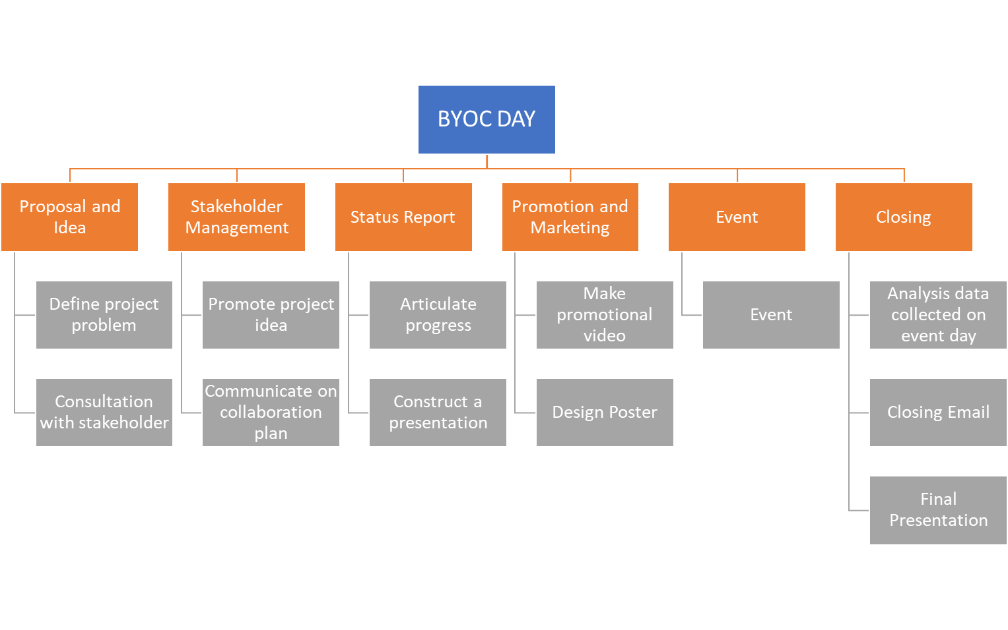
WBS and Gantt Chart
Notes:
I am going to share with you on the work breakdown structure and the schedule of the project. We try to breakdown our project into 6 steps. Proposal and idea, where our group design our project and define the problem we are going to solve and also having different meetings with the stakeholders for their experience and advice. Stakeholder management where we approach the stakeholders to promote our idea and persuade them with our project idea. After they agreed with the project, we would discuss about how we collaborate. Status report where we show our project progress and present to the class. Promotion and marketing would be the most essential part before the actual event date. We tried delivering the event details via poster, social media, our instructors. The event date would be the highlight. We asked students or staff to fill up a survey for us and we counted the number of people who is actually bringing their own cup for beverages. And each of us would be in different roles in that day.
At last, it would be the closing of our project.

Slide 6
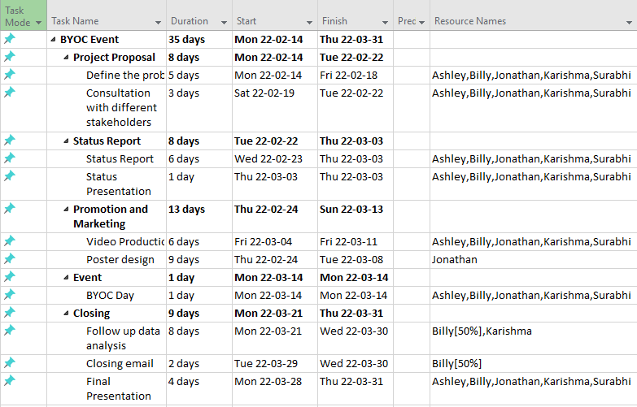
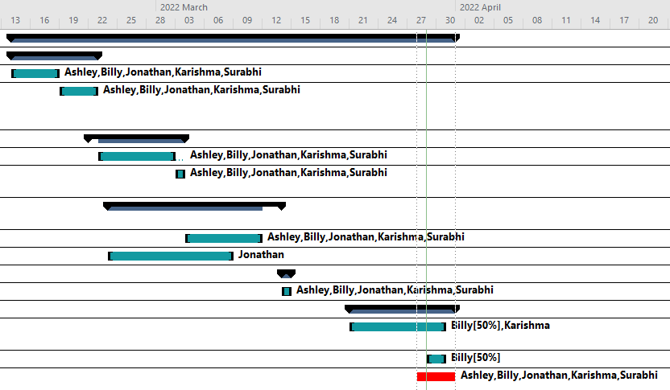
WBS and Gantt Chart
Notes:
And now this is the actual timeline that we did for this project. The project total takes 35 days including today where we are presenting now. As I mentioned before, promotion and marketing would be the key factor that determine whether the project is going to be success or not, therefore we can see we spent longer time on that activity.
Since this project is more following the deadlines and schedule of the course, we try to eliminate the dependency of each activity and try to complete the tasks in parallel. As we can see in the Gantt chart, the tasks are happening withing the same period.

Slide 7
Bottom-up Estimation
Tasks | Estimated Time | Duration | Total
Consultation with stakeholders | Define the project Meeting with MMC Discussion LSC Meeting with café managers | 4 days 1 day 1 day 3 days | 10 days
Status Report | Status report Status report presentation | 6 days 1 day | 7 days
Promotion and Marketing | Design and confirm poster Ask permission for posting posters Video production | 3 days 3 days 7 days | 13 days
Event | Design survey Plan and confirm for event details | 2 days 3 days | 5 days
Closing | Follow-up data analysis Draft and send closing email Final report and presentation | 2 days 1 day 5 days | 8 days
Time estimates | Days
Optimistic time (a) | 22
Probable time (m) | 32
Pessimistic time (b) | 43
Expected time (a+4m+b)/6 | (22+4*32+43)/6=32
Notes:
- Estimate work at the lowest possible level of detail
- walk through the team to estimate base on our experience

Slide 8
Risk Identification & Mitigation
Project
External
Government tighten COVID Regulation
Coffee Shops reject to participate
Internal
MMC x LSC opposite to co-host event
Team conflict
Notes:
Manager base on severity, chance and controllability:
External
- We communicated with all three coffee shops in Langara to make sure at least one of them would join the event.
- Also, we approached different hierarchies of those cafes, from store managers to the General manager of the organization responsible for Langara Cafeteria to make sure we got permission to promote BYOC in Langara community.
- We cannot do anything to affect the decision of the authorities, but we can see that the Covid regulations in B.C. are loosening at that time. There are less concerns on this issue.
Internal - To prevent last minute project scope rejection, we asked for approval at the earlier stage by sending emails to MMC directly before the deadline of the project proposal.
- Also, we sent our drafted project idea to Shervin to seek advice and comments before the official proposal deadline as well.
- To resolve team conflicts, we agreed to the team Code of Conduct, and we are all open to discussing our concerns. If the conflict cannot be resolved by talking out, we will perform voting among the group.

Slide 9







Stakeholder Management
power
high
low
interest
low
high
Notes:
High power high interest -> MMC club -> Manage closely -> Emails, zoom meetings and WhatsApp High power low interest -> LSU Coffee Shop, Starbucks, Tim Hortons -> Keep satisfied -> face-to-face meeting, message and emails
Low power high interest -> LSC club -> Keep informed -> Emails, zoom meetings and WhatsApp Low power low interest -> All students and staff in Langara college -> Provide general information -> D2L, social media, posters and event day survey

Slide 10

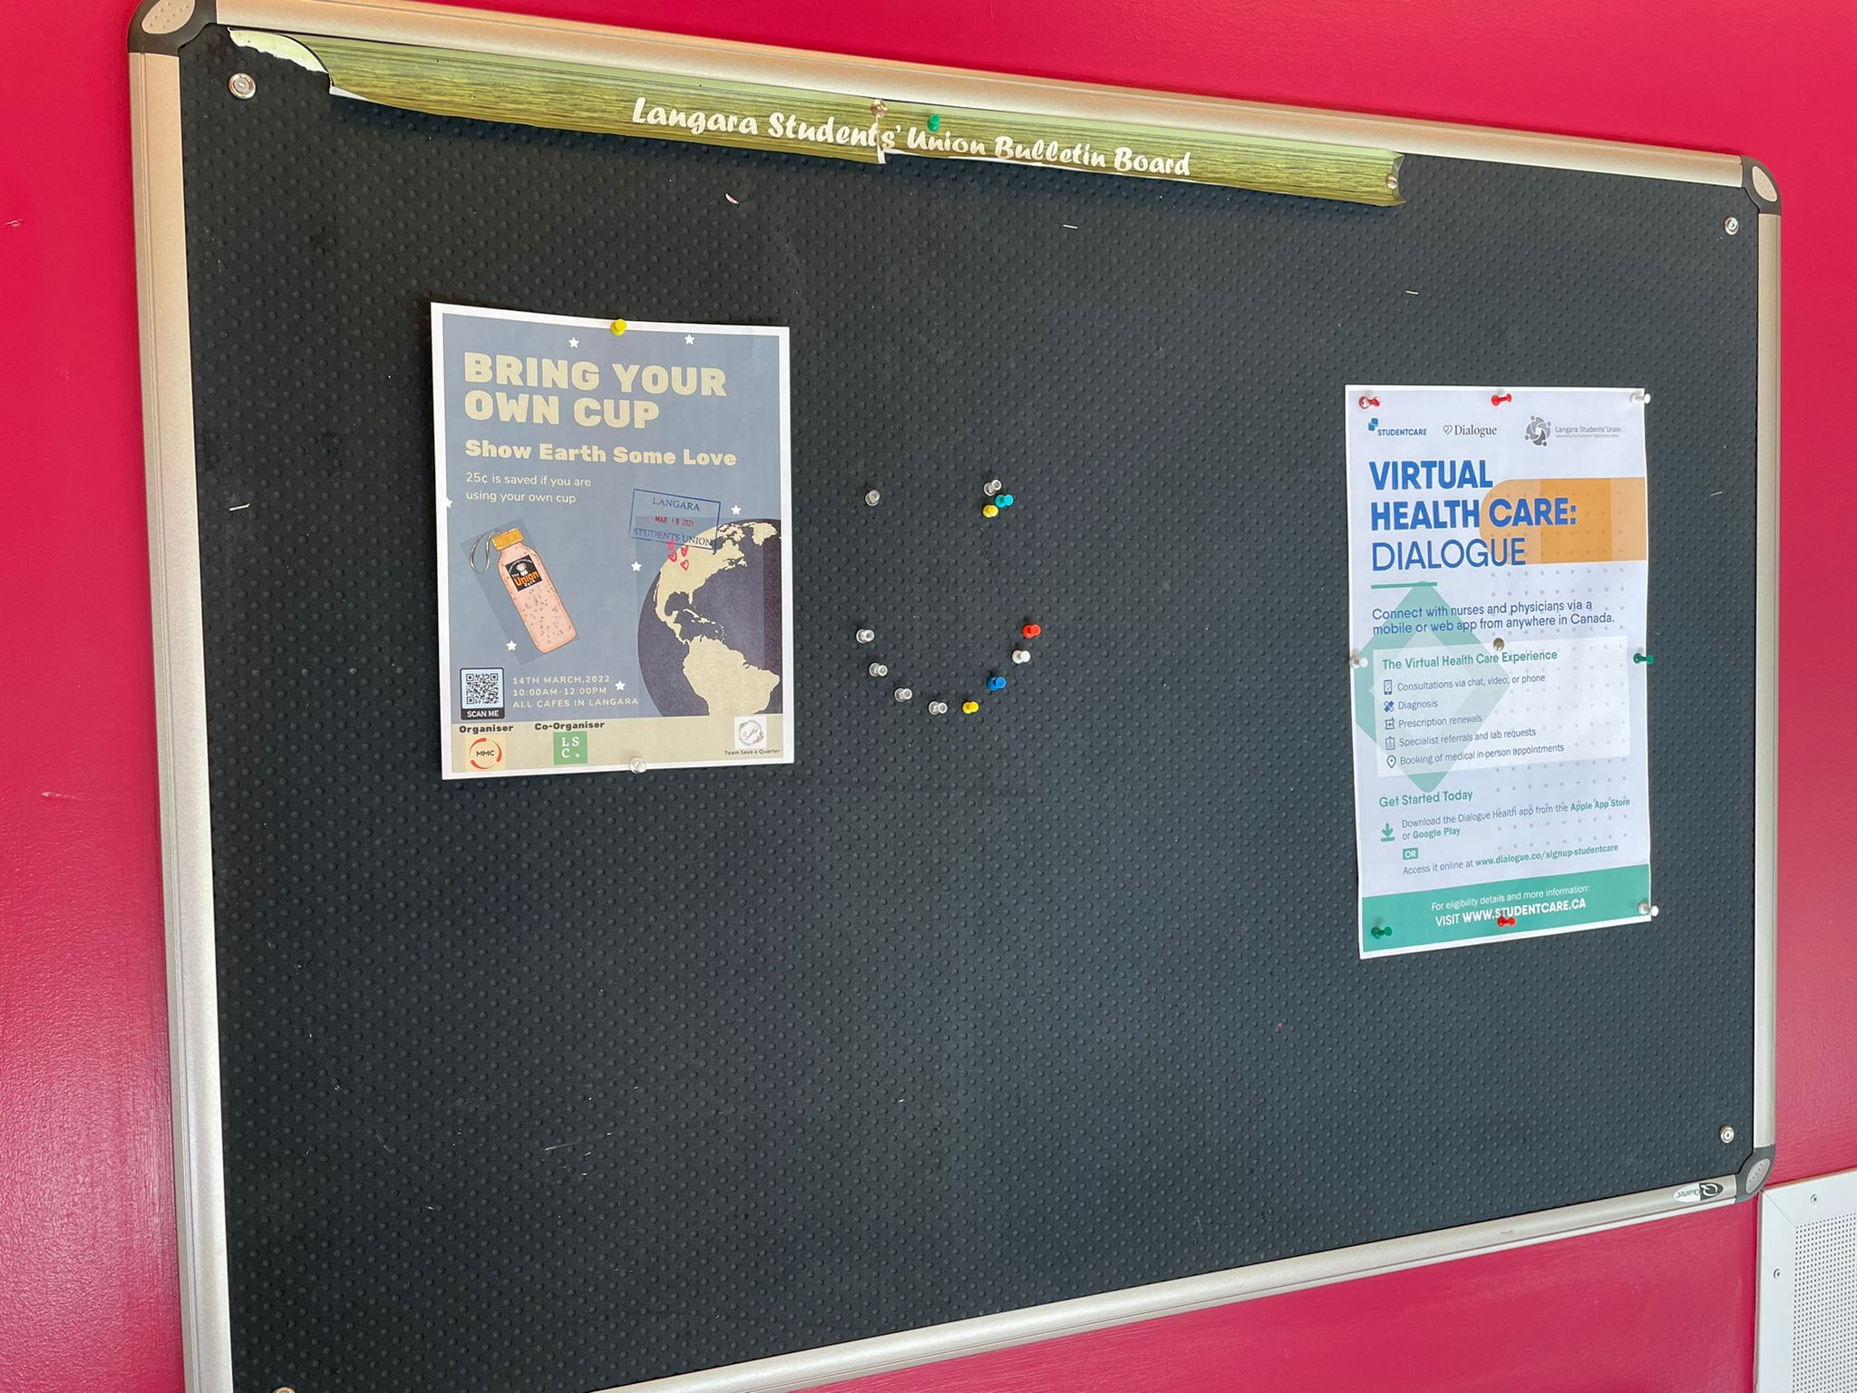
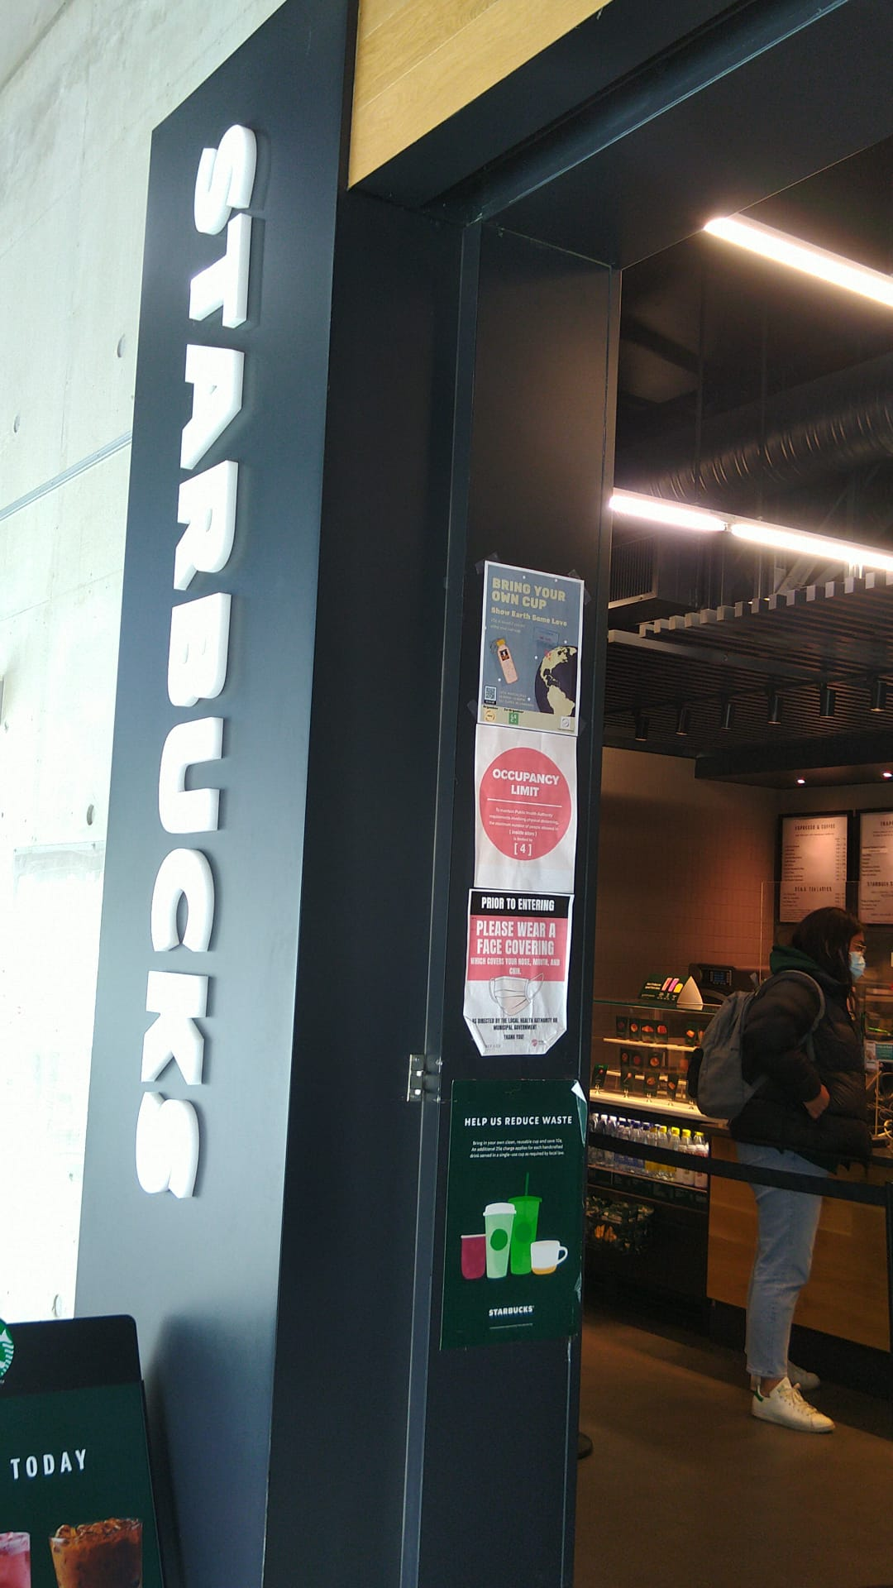
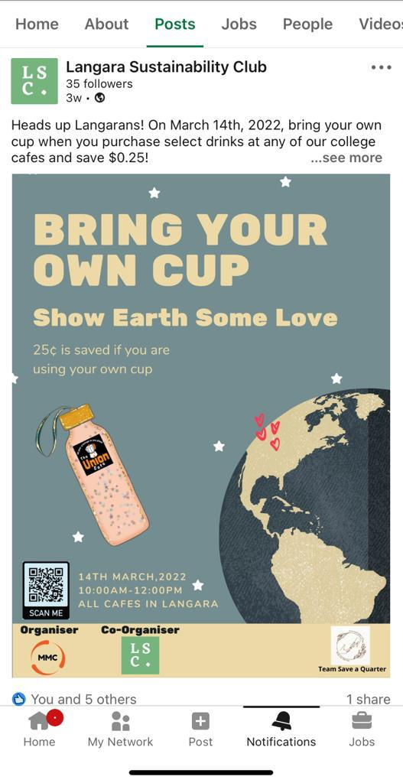
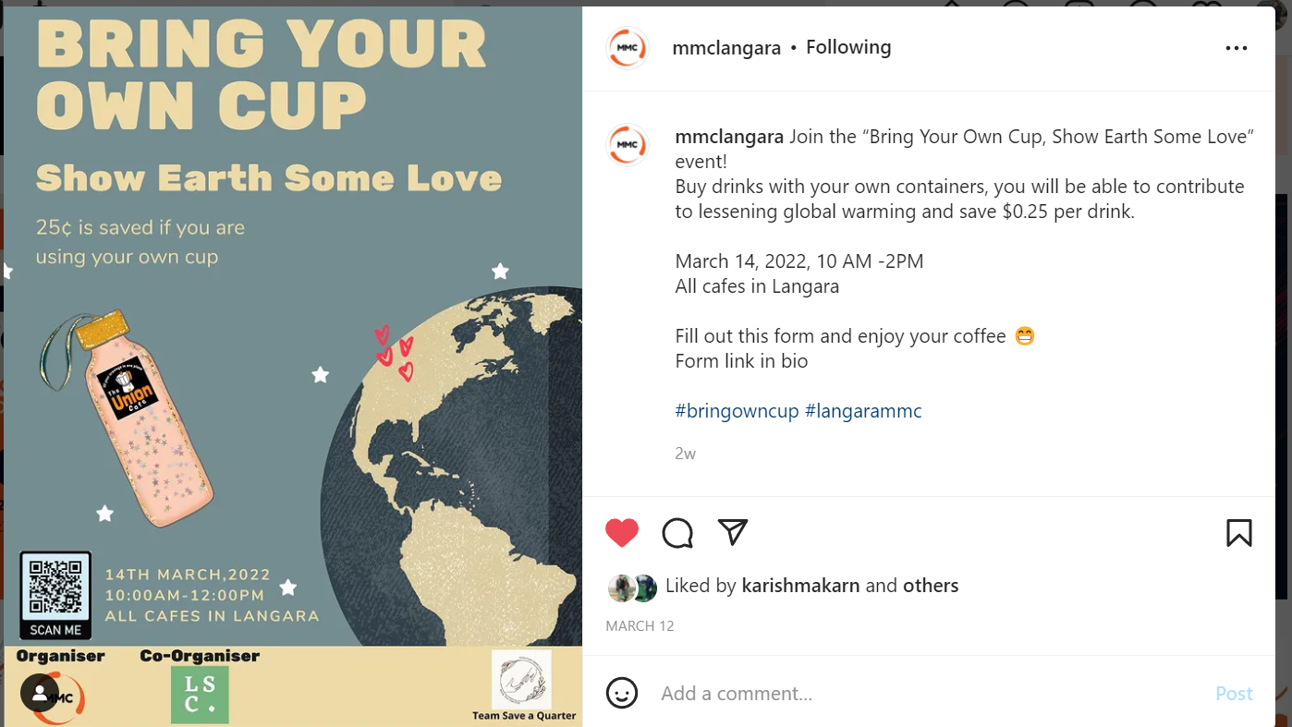
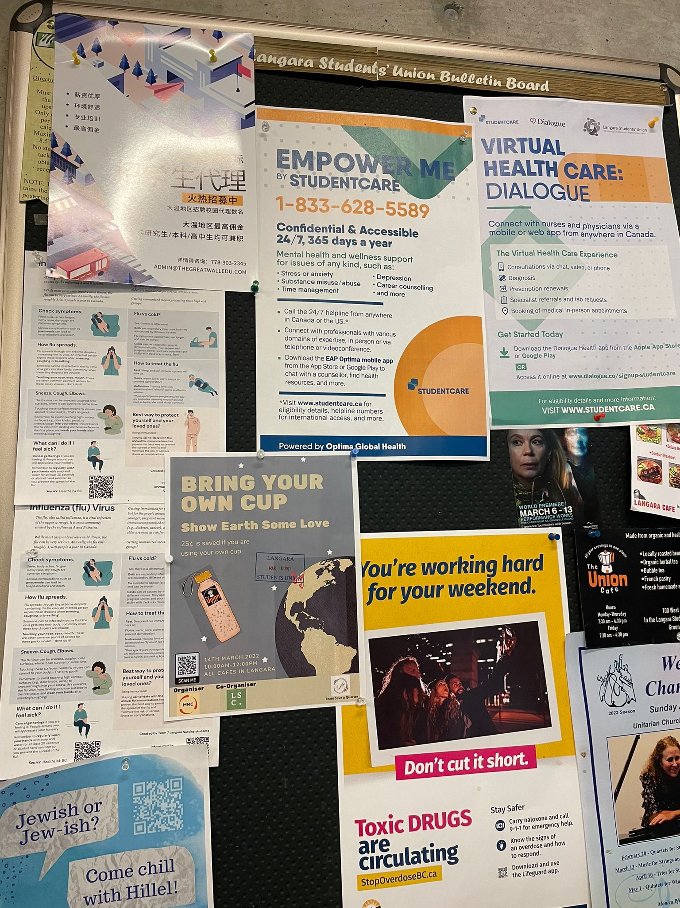
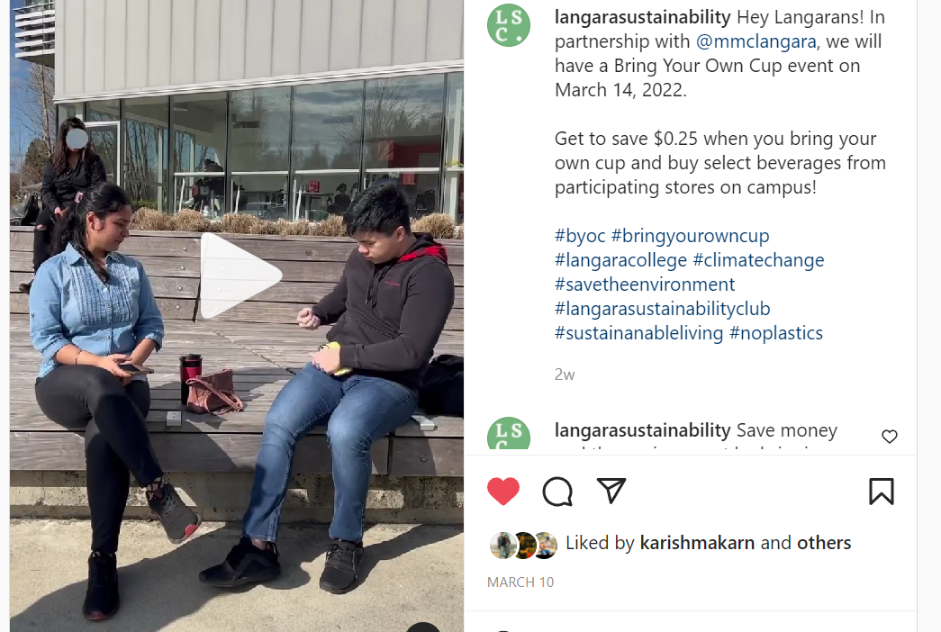
Events Promotions
Posters on 3 Notice boards and coffee shops
Posts on Instagram & LinkedIn + a 40s video
Notes:
Video link: https://www.instagram.com/p/Ca88gPeAxBR/
Notice boards locate in Student Union Building
Key Points :-
1. We started our promotional campaign with the discussion with MMC and LSC. They suggested and guided us in on-campus and off-campus promotions.
2. In On-campus campaigning we designed and pasted our posters in the LSU and Starbucks. For, Off-campus promotion MMC and LSC shared our posters in their Instagram and LinkedIn handles.
3. Our Instructors helped us in sending notifications via D2L which boosted our marketing. Additionally, LSC helped us in shooting short video which was super fun and interesting.

Slide 11
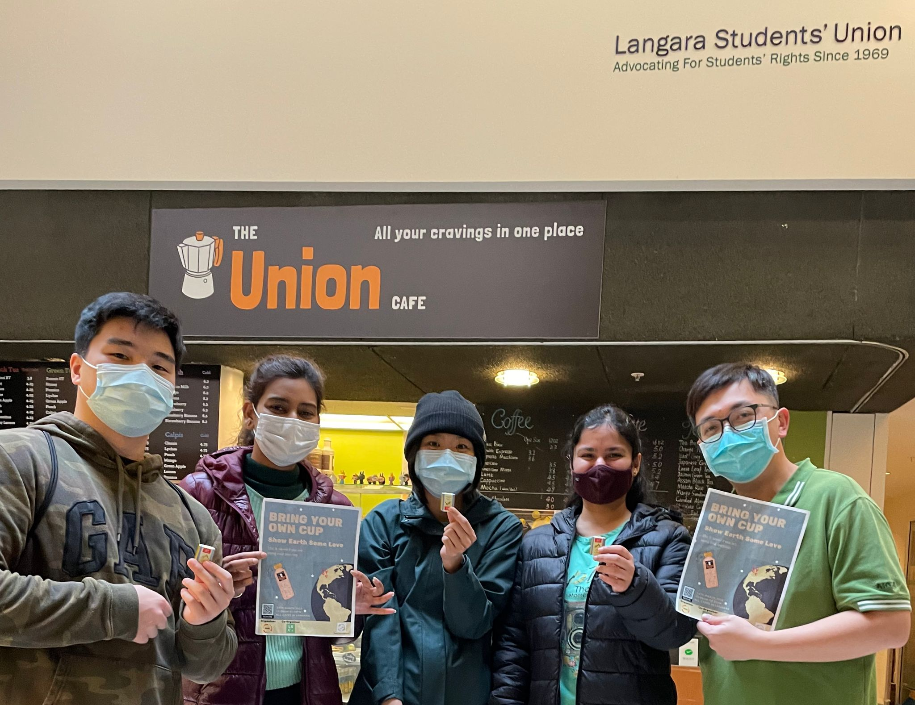
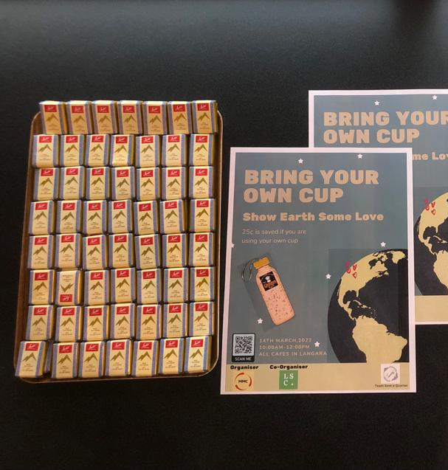
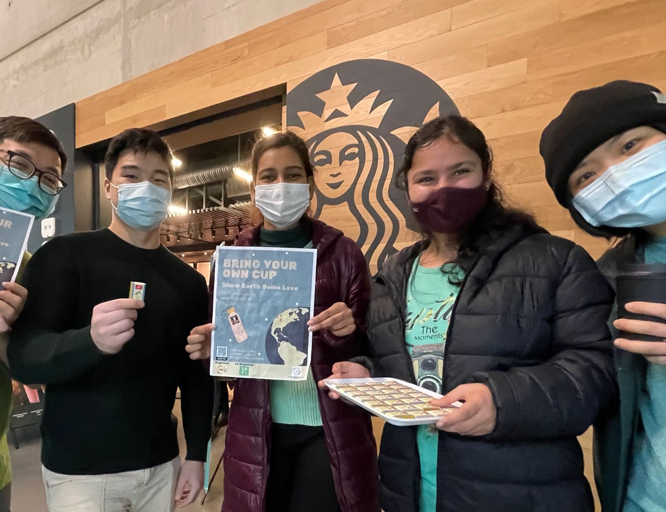
Event Day
Notes:
Event day: March 14, 2022 10am-12pm
QR code is present for people to scan and fill the survey.
Key Points :-
1. On 14th March, we first arranged all the souvenirs and our posters and than we segregated ourselves in LSU building and Starbucks.
2. We interacted with all the students and discussed regarding the challenges and got some good suggestions. Since, we were few so we moved to rest of the campus and spread awareness about bring your own cups. They helped us in filling the survey and gave their inputs.
3. We handed over chocolates as an incentives to the one's who brought their own cups. It was a fun filled on-campus event.

Slide 12
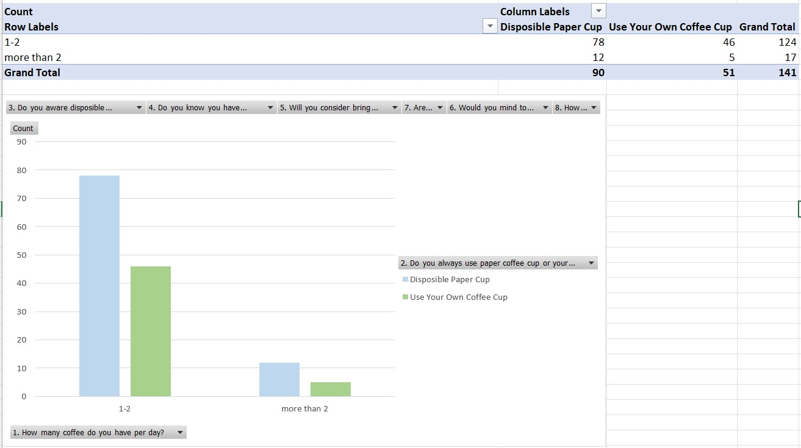
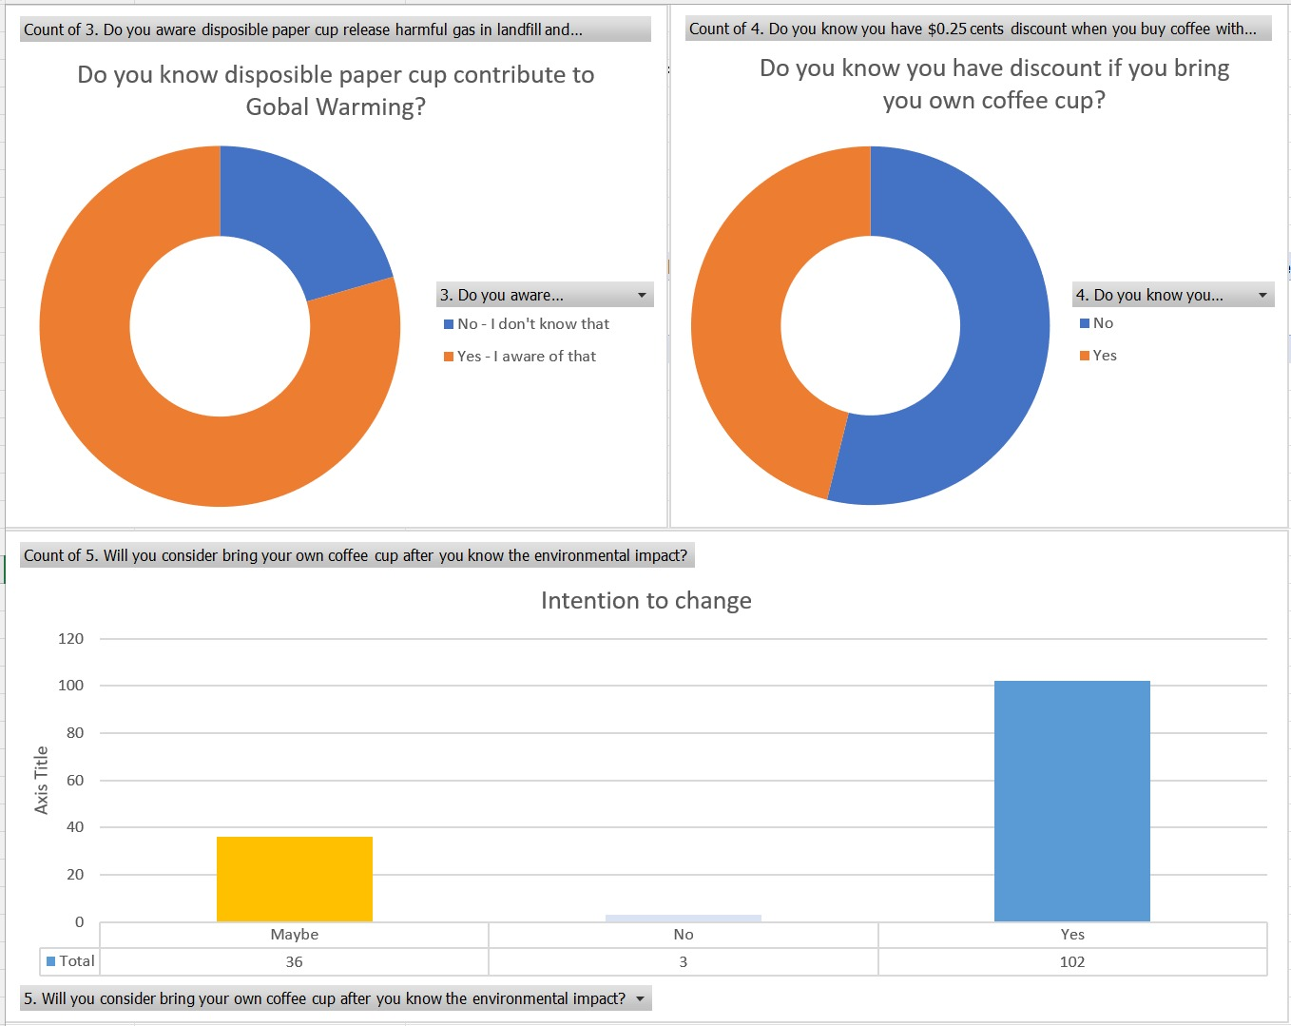
Project Measure
141 surveys taken in total:
For 1-2 cups of coffee daily
62% use disposable cup
38% bring their own cup
For more than two cups of coffee a day
70% - disposable cups
30% - own coffee cups
54% unaware of 0.25 cents discount
69% intend to bring their own cup after awareness campaign
Notes:
We create an online survey to collect feedback about the events in four areas.
* 1st area is - Coffee consumption in a day, we asked people on
- Number of coffee
- What type of cup (disposable paper cup or own cup) to use when purchasing a beverage.
In 141 surveys, we had more than 60% of customers will purchase coffee with a paper cup (85 people out of 141)
* 2nd area is about the Benefit, Impact and Intention, our questions is about
- Awareness of a discount offered for the customer to use their cup
- Disposable cups contributed to global warming in landfills.
- Intention to change after receiving the information
The surveys said, we had more than 69% of customers intended to change their buying behaviors (97 people out of 141)

Slide 13
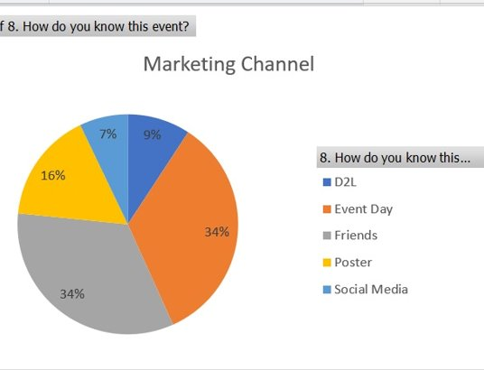
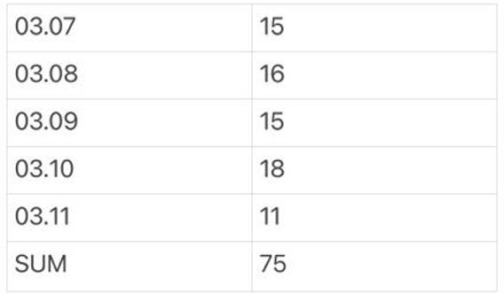
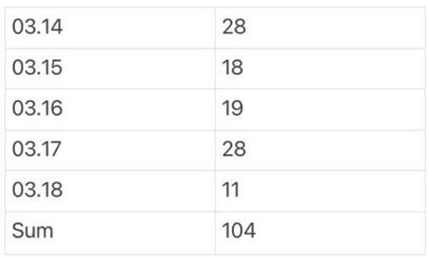
Project Measure
141 surveys taken in total:
Friend channel – 34%
Event Day Promotion – 34%
Poster – 16%
D2L Announcement – 9%
Social Media – 7%
Before event
After event
Figures show a 25% increase for the customer who purchased a drink with their cup on after the event date at LSU café from10 am to12 noon.
We classified the increment as my project of success.
Notes:
3rd area is data collection for analytics, we asked people on
- Are you a stuff or student
- Do you mind to disclose your gender.
In 141 surveys, 96% of participants are students, 68% female and 32% are male
4th area is the review of distribution channels to review our marketing strategy
- Friend channel – 34%
- Event Day Promotion – 34%
- Poster – 16%
- D2L Announcement – 9%
- Social Media – 7%
Next is the measurement after the event, Figures show a 25% (28 customers) increase for the customer who purchased a drink with their cup on after the event date at LSU café from10 am to12 noon.
Refers back to our project mission
Deliver the message that instead of using non-reusable products, we have a choice to use a reusable ones.
Motivate 30 - 50 participants to bring their cups.
Encourage at least one cafe to join the campaign.
In this case, we classified our project as a success.

Slide 14

Lesson Learned
Tight schedule (2 months) and long approval process
No centralized department for notice board usage approval.
The survey shows 35% of the participants willing to bring cups, however, lack of supporting facilities on campus and COVID restrictions.
Notes:
Tight schedule (2 months) and long approval process.
- 8 weeks is a bit tight for an on-campus event. As we need to go through several decision-making calls and meetings.
No centralized department for notice board usage approval.
- One of our pain points when doing an on-campus promotion, there is no centralised department that can provide permission for posters on all the notice board.
We need to walk into the department one by one to sell our idea and ask for permission. This process takes time.
As previously mentioned 69% of participants are willing to bring their cups, however, COVID restrictions and lack of supporting facilities on campus such as cleaning areas with soup will slow down the intention.

Slide 15

Key Success Factor
Several Key factors of project success:
Run project in Hybrid mode (Waterfall and Agile)
Define Clear Role and Responsibility
Define Milestone with Date
Risk Matrix and Mitigation Plan
Transparent to Stakeholder
Notes:
Some Key Success factors to share
Run project in Hybrid mode (Waterfall and Agile)
Waiting is not a good project strategy, some tasks perhaps can run in parallel or by shuffling from others.
For instance, a joint event is a light bulb idea that came of sudden, we create a filming script on top of other planned tasks.
Define Clear Role and Responsibility.
Remember forming, storming, norming, performing, adjourning. You don’t want to talk about responsibility when implementating the project
Define Milestone with Date
Milestone is a good way to break down project into readable stage and overcome a punctuated equilibrium model,
Risk Matrix and Mitigation Plan
Risk can be big enough to stop your project, identify a risk matrix and address them with the mitigation plan
Transparent to Stakeholder
Share the project status to stakeholder, shape their expectation

Slide 16
Q & A

Slide 17
Thank you

